Slide 1
Website
A website is a collection of web pages (documents that are accessed through the Internet)
When someone gives you their web address, it generally takes you to their website's home page, which should introduce you to what that site offers in terms of information or other services.
From the home page, you can click on links to reach other sections of the site.
A website can consist of one page, or of tens of thousands of pages, depending on what the site owner is trying to accomplish.

Slide 2




Slide 3
Virtual location on WWW, containing several subject related webpages and data files accessible through a browser.
Each website has its own unique web address (ex. www.sjc.in)which can be reached through an internet connection.
The opening page of a website is usually called homepage which contains hyperlinks to other pages on the same or other site(s).
A single web server may support multiple websites and a single website may reside multiple web pages.
A website is usually a collection of webpages

Slide 4
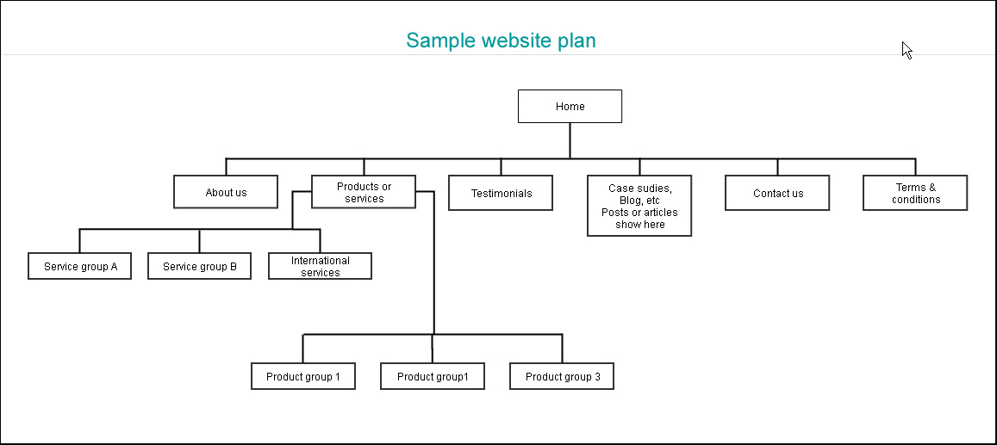

Slide 5
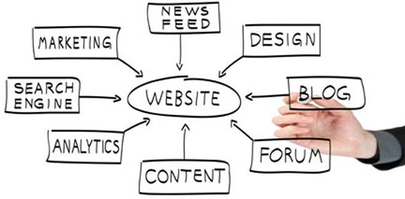

Slide 6
Why Do People Visit Websites?
Generally, people look at websites for two primary reasons:
To find information they need. This could be anything from a student looking for pictures of frogs for a school project, to finding the latest stock quotes, to getting the address of the nearest Thai restaurant.
To complete a task. Visitors may want to buy the latest best-seller, download a software program, book a movie, travel ticket, enrolling in online courseor participate in an online discussion about a favorite hobby.

Slide 7
Web Page
Definition
A web page or webpage is a document commonly written in Hypertext Markup Language (HTML) that is accessible through the Internet or other network using an Internet browser.
A web page is what you see on the screen when you type in a web address, click on a link, or put a query in a search engine.
A web page can contain any type of information, and can include text, color, graphics, animation and sound.

Slide 8
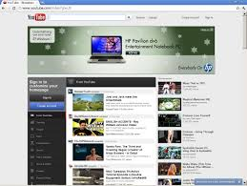
Electronic (digital) document created with HTML and, therefore, accessible with a browser.
In addition to text and graphics, webpages may also contain downloadable data files, audio and video files, and hyperlinks to other pages or sites.

